Slide 1
State Mathematics Transfer Inventory Guide Webinar
a Charles A. Dana Center
higher education initiative
2016

Slide 2
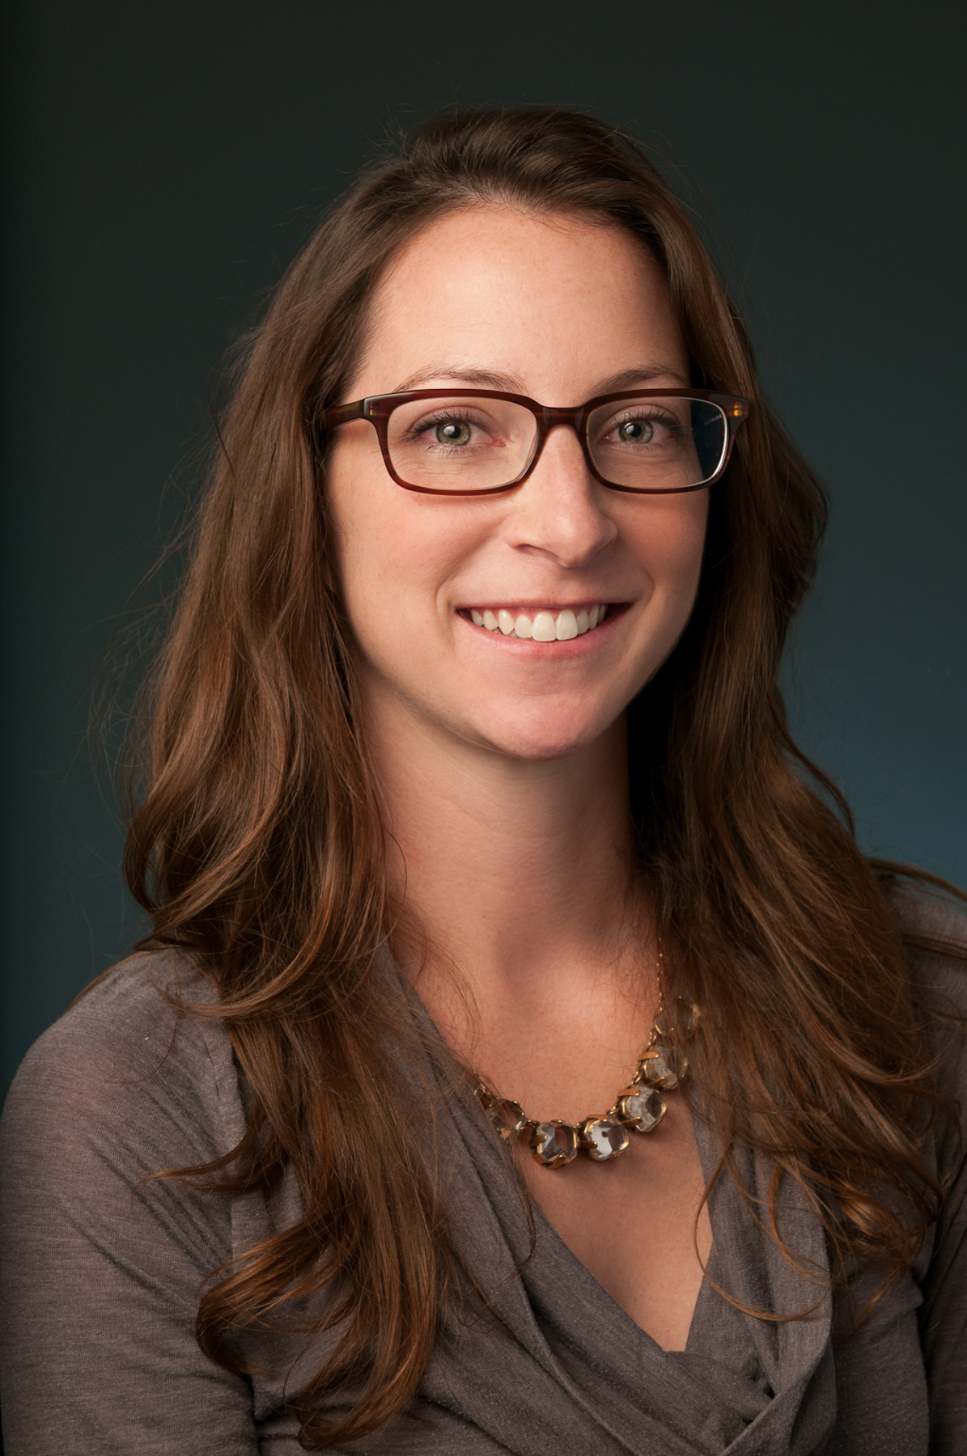
Welcome!
Agenda
Overview of the State Mathematics Transfer Inventory
Resources available to help develop an inventory
Lessons from the field
Timeline and due dates
Jenna Cullinane, Ph.D.
Strategic Policy Lead
Higher Education

Slide 3
Why?
Which math courses are currently offered at our institutions?
Which courses transfer?
Which courses are required for the same degree programs across institutions?

Slide 4
Why?
Goal: Create a one-stop resource
  to assess transfer and applicability challenges in your state,
  to inform decisions about aligning mathematics requirements with programs of study,
  to compare requirements across institutions, and
  to inform advisors and transfer students.

Slide 5
Overview: State Mathematics Transfer Inventory
Statewide resource
Lists institutions, programs of study, and math requirements

Slide 6
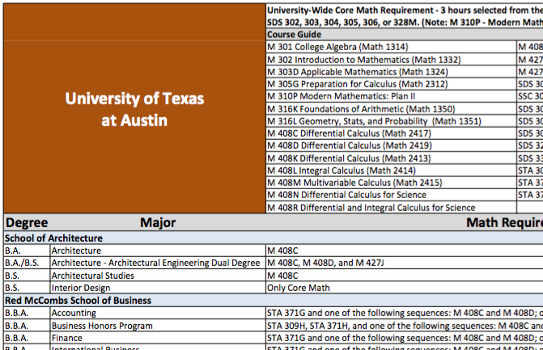
Sample Inventory: Texas

Slide 7
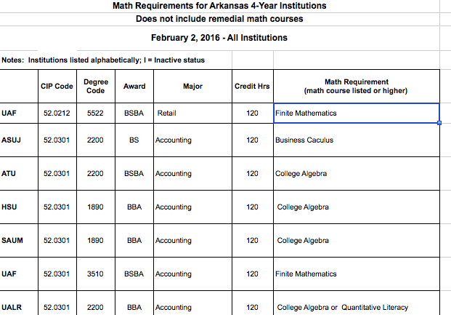
Sample Inventory: Arkansas

Slide 8
Resources
Creating a Statewide Mathematics Transfer Inventory – a step-by-step guide to develop your own inventory.
Texas Mathematics Pathways Transfer Inventory – an Excel version of the Texas inventory with a sample template for your use.
Arkansas Math Requirements Spreadsheet – an Excel version of the Arkansas inventory.

Slide 9
Creating a Statewide Mathematics Transfer Inventory
Determine your statewide priorities and parameters for data collection
  Which institutions?
  Which programs?
  What math course information?

Slide 10
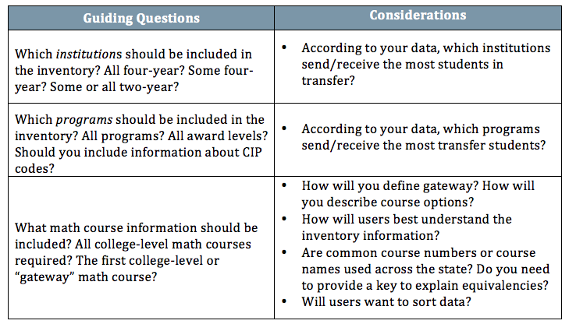
Creating a Statewide Mathematics Transfer Inventory

Slide 11
Creating a Statewide Mathematics Transfer Inventory
Create or customize a spreadsheet
Determine data collection responsibilities and collect data
Ensure accuracy

Slide 12
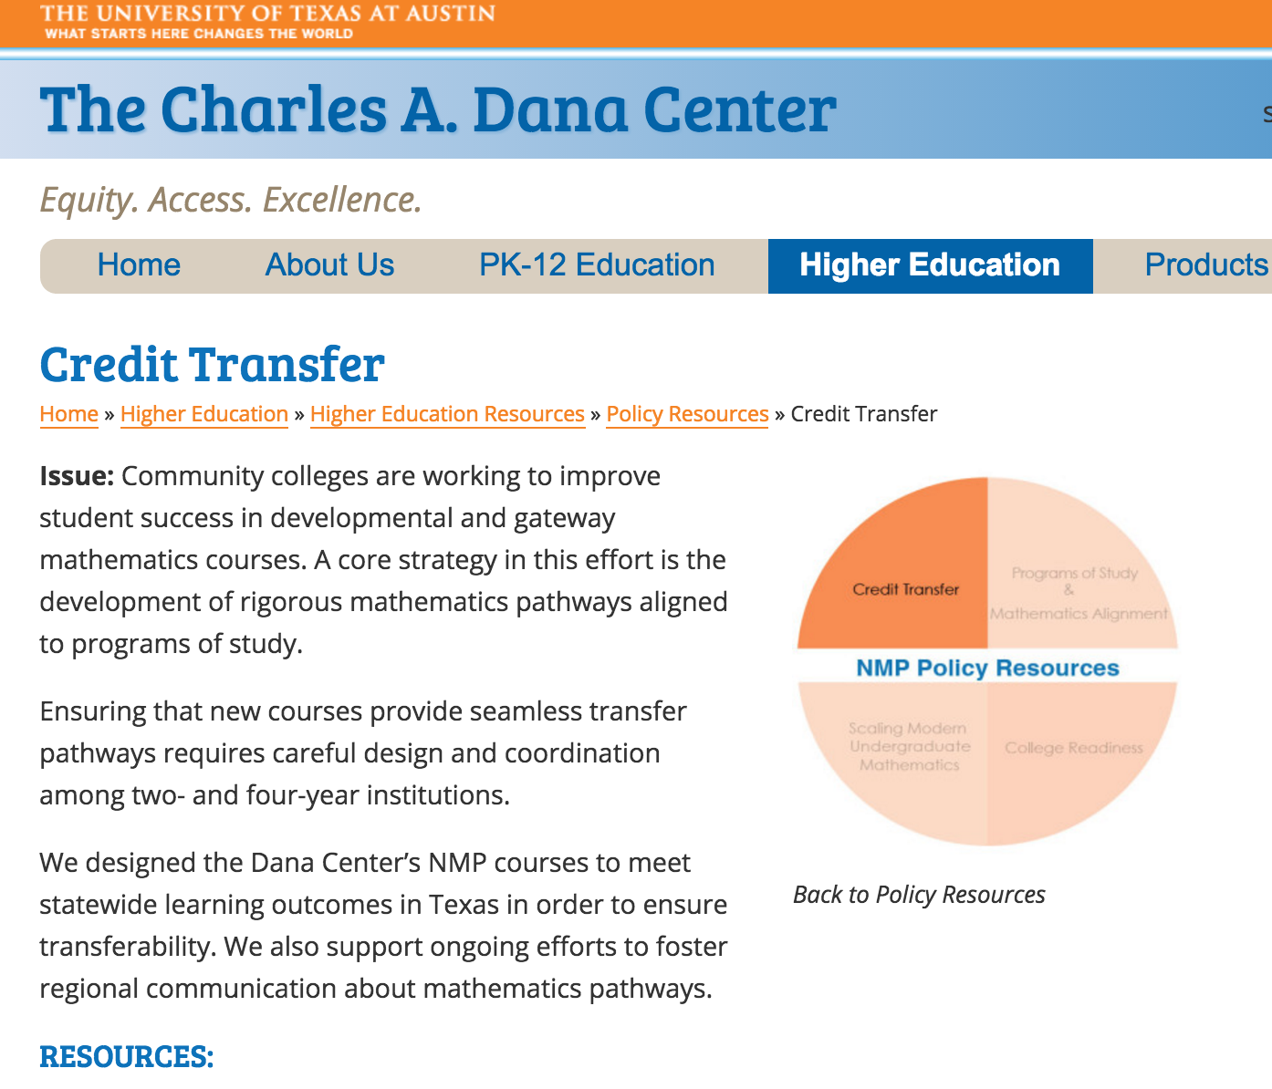
Resources – Where do I find them?
Resources can be found on the Dana Center website, Policy Resources → Credit Transfer

Slide 13
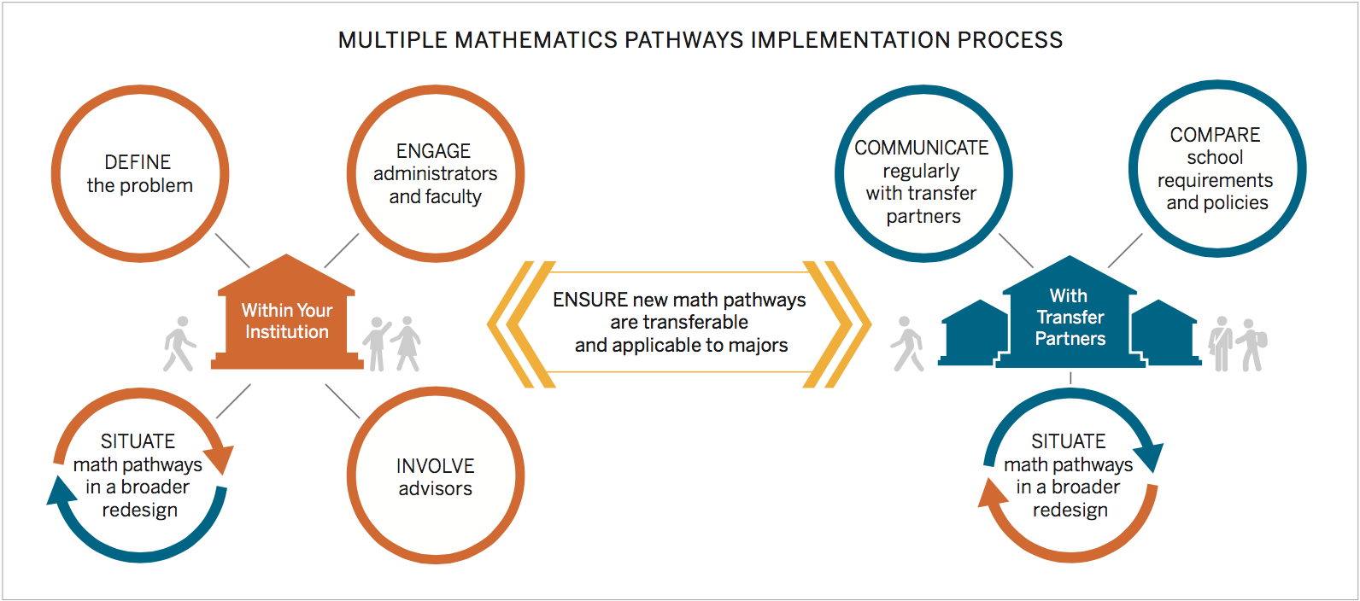
Lessons Learned

Slide 14
Lessons Learned
Use standard courses that transfer
Develop clear program maps and articulate preferred courses for each major

Slide 15
Lessons Learned
Understand what peer institutions are doing
Share data
Compare progress to accelerate implementation

Slide 16
Lessons Learned

Slide 17
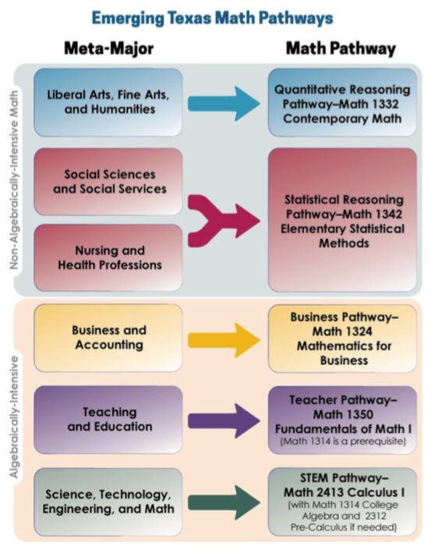
State Applicability Frameworks: Texas

Slide 18

Timeline
Estimated completion time: 4 weeks

Slide 19
Q & A
Questions?
Comments?

Slide 20
Contact Information
General information about the Dana Center: www.utdanacenter.org
Higher Education work:
www.utdanacenter.org/higher-education/
Presenter contact: jenna.cullinane@austin.utexas.edu
To receive monthly updates about the NMP, contact us at mathways@austin.utexas.edu

Slide 21

About the Dana Center
The Charles A. Dana Center at The University of Texas at Austin works with our nation’s education systems to ensure that every student leaves school prepared for success in postsecondary education and the contemporary workplace.
Our work, based on research and two decades of experience, focuses on K–16 mathematics and science education with an emphasis on strategies for improving student engagement, motivation, persistence, and achievement.
We develop innovative curricula, tools, protocols, and instructional supports and deliver powerful instructional and leadership development.

